Slide 1
Employee Data Analysis using Excel
STUDENT NAME: VANI J
REGISTER NO: 312214679
USER NAME: asunm1475312214679
DEPARTMENT: PG AND RESEARCH DEPARTMENT OF COMMERCE.
COLLEGE: SRI KANYAKA PARAMESWARI ARTS AND SCIENCE COLLEGE FOR WOMEN,CHENNAI -600001.

Slide 2
PROJECT TITLE
Employee Performance Analysis using Excel

Slide 3


AGENDA
Problem Statement
Project Overview
End Users
Our Solution and Proposition
Dataset Description
Modelling Approach
Results and Discussion
Conclusion
3/21/2024 Annual Review

Slide 4
PROBLEM STATEMENT
An employee performance analysis problem statement can be written to identify a gap in evaluating employee performance and its potential impacts. For example, a problem statement might say, "It is difficult to evaluate employee performance, which may result in increased errors, higher turnover, or reduce our ability to manage improvements".

Slide 5
PROJECT OVERVIEW
Employee performance analysis is a process that measures how employees perform on projects and assignments, and provides feedback to employees on their progress towards organizational goals. It also involves checking if performance standards and elements are realistic.

Slide 6


WHO ARE THE END USERS?
Human Resources Team
Managers
Executives
Training and Development Teams
Compensation and Benefits Teams
6. Performance Review Committees

Slide 7
OUR SOLUTION AND ITS VALUE PROPOSITION
A value proposition is a statement that summarizes the value of a solution, and is usually one sentence or phrase. It's more than just a description of a product or service, but rather the solution that a business provides and the value that a customer can expect. A value proposition is focused on the customer perspective and outcome, and should be relevant, explain the value of the offer, and differentiate the brand from competitors.

Slide 8
DATASET DESCRIPTION
EMPLOYEE ID: Unique identifier for each employee in the organization.
FIRST NAME: The first name of the employee.
PAY ZONE: The pay zone or salary band to which the employee's compensation falls.
DEPARTMENT TYPE: The broader category or type of department the employee's work is associated with.
CURRENT EMPLOYEE RATING: The current rating or evaluation of the employee's overall performance.

Slide 9
THE "WOW" IN OUR SOLUTION
While taking pivot count is considered as important so each and every person is considered as COUNT 1.
While taking pivot count is considered as important so each and every person is considered as COUNT 1.
The 'wow' moments truly occur when we are impressed. When someone makes us feel appreciated, respected and heard, we are impressed.
'Wow' is down to how you make your customers feel.
•Performance level=IFS(28>=5,"VERY HIGH", 28>=4,"HIGH", 28>=3,"MED", TRUE, "LOW")
3/21/2024 Annual Review
9

Slide 10
MODELLING
DATA SET: 1.Kaggle 2.Employee dataset FEATURE SELECTION: 1.Slicer. 2.Conditional Formatting. 3.Designing DATA CLEANING: 1. Missing values. 2. Irrelevant data. 3.Correct Errors. PIVOT TABLE: 1. Employee ID. 2. First Name.
10

Slide 11
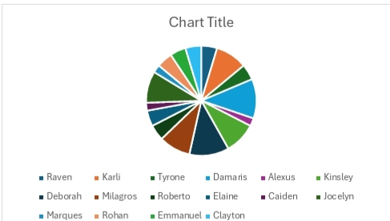
RESULTS
11

Slide 12
CONCLUSION
In conclusion, conducting an employee perjormance analysis using Excel provides a structured and efficient way to evaluate and track performance metries. Excels sersalile junctions and teals, such as pivot tables, charts, and conditienel Lormatting, allow for clear data visualization and analysis, tacilitating intermed decision making.

